Slide 1

19ECE204 DIGITAL ELECTRONICS AND SYSTEMS L-T-P-C: 3-1-0-4 Lecture 5

Slide 2
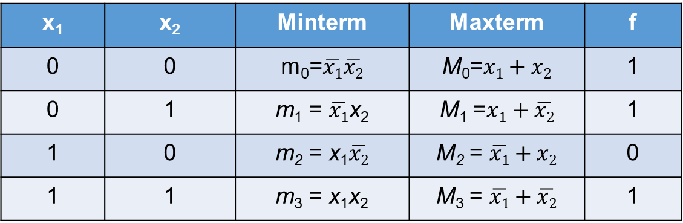
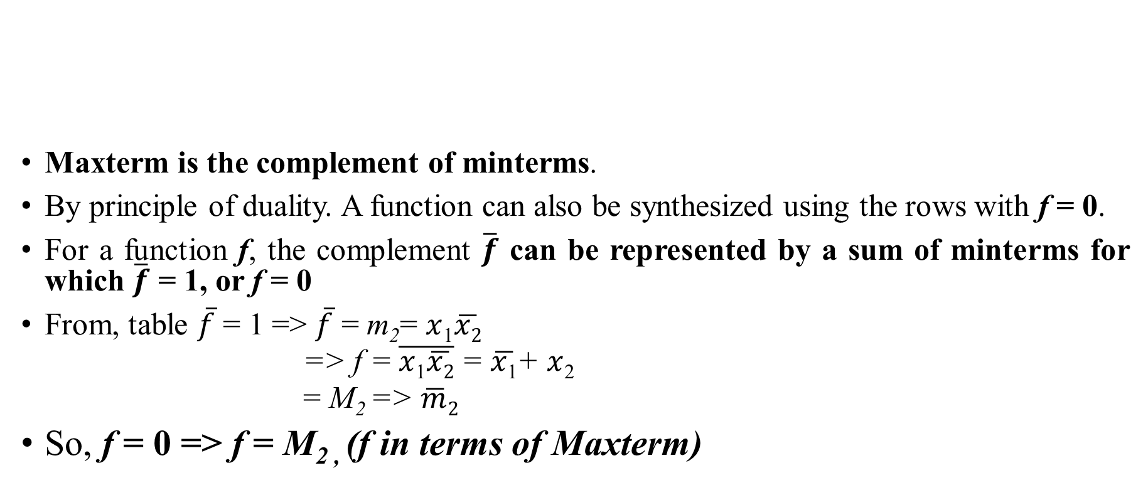
Maxterms & Product-of-Sums (POS) Form
x₁ | x₂ | Minterm | Maxterm | f
0 | 0 | m₀=$\overline{x1}\overline{x2}$ | M₀=$x1+x2$ | 1
0 | 1 | m₁ = $\overline{x1}$x₂ | M₁ =$x1+\overline{x2}$ | 1
1 | 0 | m₂ = x₁$\overline{x2}$ | M₂ = $\overline{x1}+x2$ | 0
1 | 1 | m₃ = x₁x₂ | M₃ = $\overline{x1}+\overline{x2}$ | 1
Maxterm is the complement of minterms.
By principle of duality. A function can also be synthesized using the rows with f = 0.
For a function f, the complement $\overline{f}$ can be represented by a sum of minterms for which $\overline{f}$ = 1, or f = 0
From, table $\overline{f}$ = 1 => $\overline{f}$ = m₂= $x$₁$\overline{x2}$
=> f =$\overline{x\text{1}\overline{x2}}$ = $\overline{x\text{1}}$+ $x$₂
= M₂ => $\overline{m}2$
So, f = 0 => f = M_{2 ,} (f in terms of Maxterm)

Slide 3
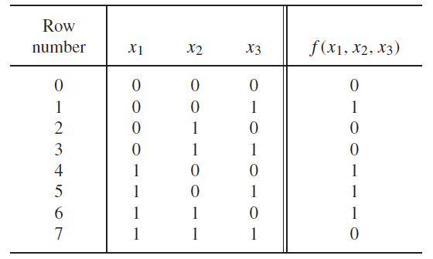




Ex.2
To synthesize for f=0. We shall take $\overline{f}=1$and $\overline{f}$ as sum of m₀,m₂, m₃ and m₇
i.e
This expression represents f as a product of maxterms.

Slide 4
Contd..
A logic expression consisting of a logical product (AND) term of various logical sum (OR) terms is said to be of the product-of-sums (POS) form.
If each SUM term is a Maxterm, then the expression is called a canonical product-of-sums form.
The previous function can be simplified by rewriting f as,
Using property , We get,

Slide 5
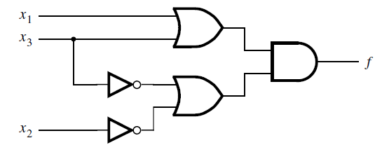
Contd..
The simplified expression is thus,
The circuit is shown in figure,
Here the cost is coincidently 13 same as SOP. But it may vary in general.
Short hand notation for POS is
or

Slide 6
Summary of Standard Forms of Boolean Expressions
The Sum-of-Products(SOP) Form. Ex) AB+ABC, ABC+CDE+B’CD’
The Product-of-Sums(POS) Form. Ex) (A+B)(A+B+C), (A+B+C)(C+D+E)(B’+C+D’)
Principle of Duality : SOP ⇔ POS
Domain of a Boolean Expression : The set of variables contained in the expression
Ex) A’B+AB’C : the domain is {A, B, C}
Procedure to get Standard SOP Form (Canonical SOP Form)
For all the missing variables, apply (x+x’)=1 to the AND terms of the expression
List all the min-terms in forms of the complete set of variables in ascending order
Ex. : Convert the following expression into standard SOP form: AB’C+A’B’+ABC’D
Sol) domain={A,B,C,D}, AB’C(D’+D)+A’B’(C’+C)(D’+D)+ABC’D =AB’CD’+AB’CD+A’B’C’D’+A’B’C’D+A’B’CD’+A’B’CD+ABC’D =1010+1011+0000+0001+0010+0011+1101 => m₀+m₁+m₂+m₃+m₁₀+m₁₁+m₁₃
=Σ(m₀,m₁,m₂,m₃,m₁₀,m₁₁,m₁₃) = Σ(0,1,2,3,10,11,13)

Slide 7
Procedure to obtain Standard POS Form (Canonical POS Form)
For all the missing variables, apply (x’x) = 0 to the OR terms of the expression
List all the max-terms in forms of the complete set of variables in ascending order
Ex : Convert the following expression into standard POS form: (A+B’+C)(B’+C+D’)(A+B’+C’+D)
Sol) domain ={A,B,C,D},
(A+B’+C)(B’+C+D’)(A+B’+C’+D)
(A+B’+C+D’D)(A’A+B’+C+D’)(A+B’+C’+D)
(A+B’+C+D’)(A+B’+C+D)(A’+B’+C+D’)(A+B’+C+D’)(A+B’+C’+D)
(0101)(0100) (1101)(0101)(0110) => M₄M₅M₆M₁₃
ΠM(4,5,6,13)

Slide 8

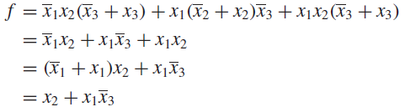

Problem : If f(x_{1,}x_{2,}x₃)=Σm(2,3,4,6,7)=ΠM(0,1,5). i) Express in terms of canonical SOP and POS form. ii)Simplify to obtain the cost efficient designs.
Sol: Canonical SOP form is,
This expression can be simplified using the identities as,
Canonical POS form is,

Slide 9
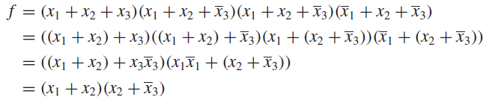
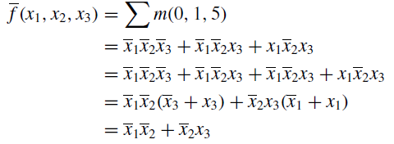
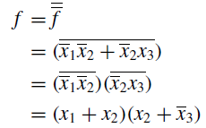
Contd..
This expression can be simplified using the identities as,
Another way of deriving this product-of-sums expression is to use the sum-of-products form

